Slide 1
For Instructors on the Individual Instructor Plan or Institution-Wide Plan
How Instructors use this Registration Guide:
This guide will to help your students register for your Poll Everywhere account. Please customize this for your specific situation.
Students will need one of the following to locate your account:
Instructor’s email address for the account
Invitation link. Your personal link can be found at
https://www.polleverywhere.com/participants under the red add participants button
Access code (bundled with a textbook)
The next slide is an email template you can use which will help registered students ensure they are getting credit for responses.

Slide 2
For Instructors
Email Template:
Dear Students,
To ensure that your responses are being recorded and you've registered for my class properly, please follow these steps:
1. Log-in to your account at www.polleverywhere.com
2. Look under "Settings" and select "Voter Registration."
3. Click "details" next to my name. If you don't see my name or course on this page, please click the link on that page to register as a voter
4. If texting, fill your phone number then text the word CERTIFY to 22-333 to certify your mobile number.
There are a few things to be aware of before voting: If you are trying to respond via web, please be sure you're logged in to your PollEv account on that web device. If you are trying to respond via text, please be sure your mobile phone number is accurate at pollev.com/profile/edit, and it is certified.
Please contact support@polleverywhere.com if you are having trouble with this process.
Thank you

Slide 3
Student Guide to Poll Everywhere
How do I use Poll Everywhere?
After you register, you’ll mostly be responding (unless you choose to create polls of your own!). You can respond via text, on the web, or mobile app.
In this guide you will learn:
1: How to locate your course
2: How to register
3: How to certify your registration
What is Poll Everywhere?
Poll Everywhere is a web-based class participation system. You can use it to instantly reply to multiple choice questions, open-response questions, and clickable image polls your professor will display.
Why register?
Registering as a participant is necessary if your instructor gives credit for participation. Some instructors may grade your responses for credit. This is also a great way give feedback or make sure your voice is heard in the classroom! By creating and registering your account you can also track how you’ve responded over time. This is useful for study and review.

Slide 4
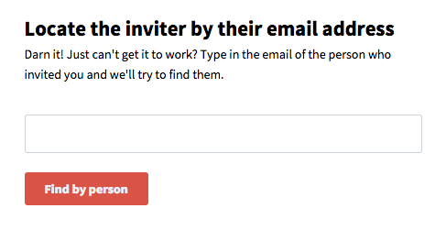
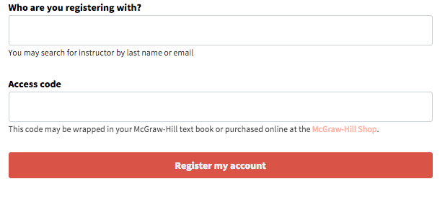
Registering With Your Instructor
Step 1 - Locate your Course
What info do you have?
An instructor’s email address www.polleverywhere.com/register
An invitation link (Use the unique link the provided by your
instructor.
An access code from your textbook www.polleverywhere.com/redeem

Slide 5
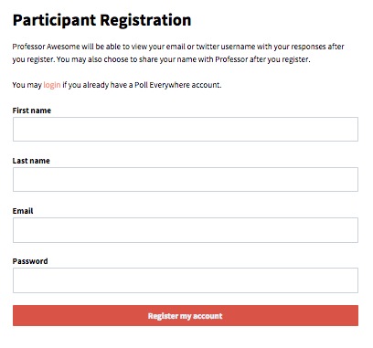
Step 2- Sign Up
If you already have an account, please be sure to use the login link. This will register your existing account as a participant for your new course.

Slide 6
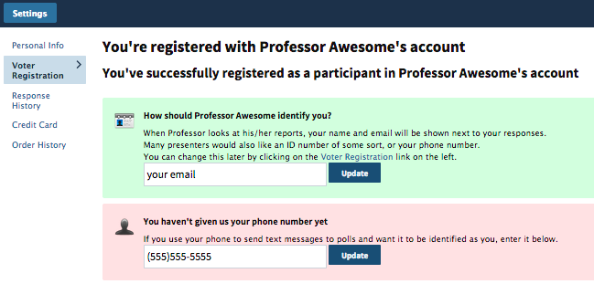
Step 3- Confirm Registration & Certify Your Mobile Number
Confirm how you want your instructor to identify you (usually student ID, email, or
Name).
If you plan to respond via text, enter your mobile number and click “Update”.
You should get a message that you need to certify your mobile number by sending the text message “CERTIFY” to 22333. You should get a reply message indicating that your Poll Everywhere account has been set up and that your mobile number is successfully linked to your Poll Everywhere account.
To access this page again, simply login to your account, select at the top, and then
along the left. Click “Details” to the right of your Instructor’s name.

Slide 7
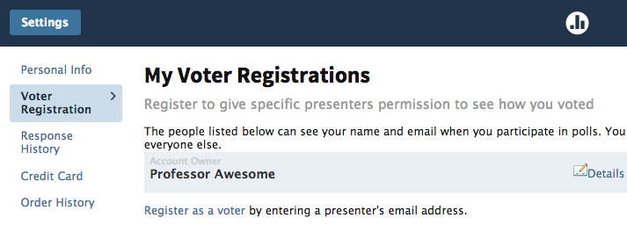
Student FAQ’s:
How can I see my response history?
You can always check your Response History under
to see the date and time you responded, or to verify your attendance in a class.
I’m texting to the short code (22333 or 37607), why am I getting an error message?
Your cell carrier may block the use of short codes. US participants can try texting to the number (747) 444-3548.
What if my responses are not showing up in my response history?
If you are trying to respond via web, please be sure you're logged in to your PE account somewhere on your computer or smartphone. If you are trying to respond via text, please be sure your mobile phone number is included as part of your account info, and that it is certified.
Still having trouble? Check out our FAQ page, email your professor or support@polleverywhere.com

